Slide 1
Fast Real-World Classification of
ECH-enabled
Applications
Yizhak Kahana (Allot,BIU)
Yaakov (J) Stein (Allot)
Oren Glickman (BIU)
Research partially funded by IIA under ENTM MAGNET consortium
Previously presented at CSCML-2024 (BGU)
Submitted to IEEE Transactions on Machine Learning in Communications and Networking

Slide 2
The problem - introduction of ECH
Over the past few years Internet traffic is becoming more fully encrypted
Deep Packet Inspection exploits information leakage
mostly from metadata fields that are still unencrypted
One notable example is SNI in the Client Hello of the TLS handshake
Since the cyber suite has not yet been agreed upon
the CH message is unencrypted, and thus leaks SNI and other information
Encrypted Client Hello, as its name implies, encrypts the TLS CH message
using a public key obtained from, e.g., a DNS (HTTPS-RR) response message
(ECH is still not an IETF RFC after 6½ years)

Slide 3
Operational requirements
To replace DPI we need classification of individual applications (not merely traffic classes)
and real-time operation at high rates (100s of Gbps)
In order to be operationally acceptable, we further require:
speed application classification within one second of traffic
accuracy needs to be 95% or higher (similar to current DPI)
scale needs to scale to many hundreds of applications (classes)
stability drift needs to be no more than a few percent per month
Notes:
hello

Slide 4
Key Contributions
Large Real-World Dataset and Accurate Labeling
we trained and tested on huge set of real-world network data
data labeled using a state-of-the-art commercial DPI system
Utilize nonencrypted Per Packet Information (PPI) as features
PPI means packet arrival time, direction (client to server or reverse), size
we avoid statistical features that require long collection durations
Hierarchical Architecture instead of a single large flat architecture
we use a hierarchical architecture
with a large number of smaller ML models
based on clustering server IP addresses
Notes:
hello

Slide 5
Flat vs. Hierarchical Architecture
Flat Architecture
single large model with PPI as input and hundreds of outputs
Hierarchical Architecture
model selected by unencrypted server IP addresses
faster training
higher accuracy
less impactful errors

Slide 6
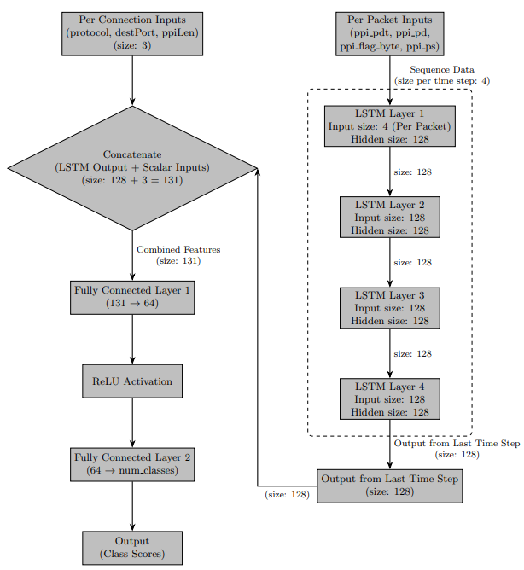
ML Models
Random Forest (RF) Model
runs on CPU-only platforms
slightly lower accuracy
Deep LSTM Model
4 LSTM layers
to capture temporal dependencies
afterwards adds per-connection data
Deep LSTM with attention
Similar to previous
but exploits multiple past LSTM steps

Slide 7
Results
We collected about 200 nontrivial connections per second
We trained on 4 days of traffic (> 75 million connections)
tested on traffic from the following week and from 1 and 2 months later
Hierarchical architecture was consistently > 5% better than the flat one
When allowing 50 packets in the PPI input data
accuracy was 94% for RF model
slightly better for deep LSTM (adding attention didn’t further improve)
drift degradation under 2% per month
When limiting ourselves to 10 packets in the PPI input data
accuracies were about 1% lower across the board

Slide 8
Insights
Data is king !
with tens of millions of training examples
the application classification problem becomes remarkably easy
Exploiting domain knowledge is better than throwing ML at the problem
hierarchical architecture performs better than inputting server IP cluster as feature
Simple classifiers suffice
deep architectures with attention are not appreciably better than simple RF
The long tail may still be a problem
majority of the traffic is due to a small number of applications
myriads of very rare applications are (correctly) classified as other
Granular classification can be fast
tens of packets suffice, traffic class (VoIP, video streaming, etc.) may require many seconds

Slide 9
What about other privacy-enhancing methods?
ECH is a special case in that it leaves the IP layer unencrypted
but there seem to be no other tractable cases of interest
IPsec tunnel mode masks IP layer, but multiplexes many application flows
hence the problem is ill-defined (unless demux is possible)
VPNs and OHTTP (e.g., APR) similarly mask IP and multiplex flows
and have begun adopting MASQUE which mux streams in a single packet
Traffic obfuscation methods (PriFi, Loopix, BuFLO, TARANET, ditto)
delay packets to disguise interpacket timing behavior
add chaff packets, divide/merge/pad all packets to same length (overhead < 10%)
leave only session duration

