Slide 1

Fast Real-World Classification of
ECH-enabled
Applications
Yizhak Kahana
Yaakov (J) Stein
Gabriel Zigelboim
Oren Glickman

Slide 2
The problem - introduction of ECH
Deep Packet Inspection exploits information leakage
mostly from metadata fields that are still unencrypted
A notable example is SNI in the Client Hello of the TLS handshake
Since the cyber suite has not yet been agreed upon
the CH message is unencrypted, and thus leaks SNI and other information
Over the past few years Internet traffic is becoming more fully encrypted
In particular Encrypted Client Hello, as its name implies,
encrypts the TLS CH message
using a public key obtained, e.g., from a new DNS response message

Slide 3
Operational requirements
In order to be operationally acceptable, we require:
speed application classification within one second
accuracy needs to be 95% or higher (similar to current DPI)
scale needs to scale to hundreds of applications (classes)
stability drift needs to be no more than a few percent per month
Notes:
hello

Slide 4
Key Contributions of Our Research
Real-World Data and Accurate Labeling
we trained and tested on huge set of real-world network data
data labeled using a state-of-the-art commercial DPI system
Utilize nonencrypted Per Packet Information (PPI) as features
PPI means packet arrival time, direction (client to server or reverse), size
we avoid statistical features that require long collection durations
Hierarchical Architecture
in addition to a single large flat architecture
we use a hierarchical architecture
with a large number of smaller ML models
leveraging domain knowledge to distinguish between them
Notes:
hello

Slide 5
Hierarchical Architecture
Flat Architecture
single model with PPI as input and hundreds of outputs
Hierarchical Architecture
model selected by unencrypted server IP addresses
    faster training
    higher accuracy
    less impactful errors

Slide 6
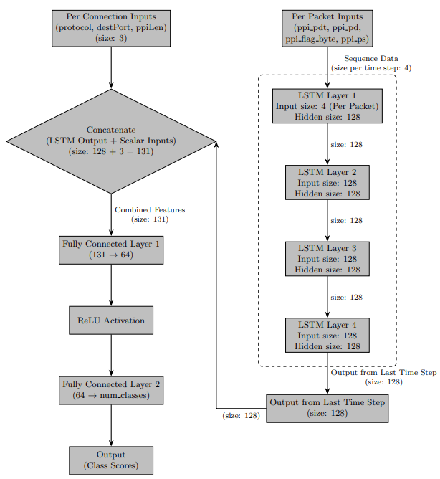
ML Models compared
Random Forest (RF) Model
  runs on CPU-only platforms
  here only slightly lower accuracy
Deep LSTM Model
  4 LSTM layers
  to capture temporal dependencies
  afterwards adds per-connection data

Slide 7
Results
We collected about 200 nontrivial connections per second
We trained on 4 days of traffic (> 75 million connections)
tested on traffic from the following week and from 1 and 2 months later
Hierarchical architecture was consistently > 5% better than the flat one
When allowing 50 packets in the PPI input data
accuracy was about 94% for RF model
slightly better for deep LSTM
drift degradation under 2% per month
When limiting ourselves to 10 packet in the PPI input data
accuracies were about 1% lower across the board

