Slide 1

Countering
the ECH
Threat
YJS

Slide 2
ECH
DPI engines exploit information leakage
mostly from metadata fields that are still unencrypted
A notable (but far from the only) example is SNI
The TLS handshake, in which the sides agree on encryption mechanisms
consists of a Client Hello message followed by a Server Hello
The CH specifies
the cyber suites the client supports
various crypto-related parameters
optionally the name of the server (SNI) the client wants to reach
since there may be many virtual servers hiding behind a single IP address!
Since the cyber suite has not yet been agreed upon
the CH message is unencrypted, and thus leaks SNI and other information

Slide 3
ECH
Over the past few years Internet traffic is becoming more fully encrypted
Fully encrypted traffic minimizes leakage
in order to increase the privacy of the IP protocol suite
In particular Encrypted Client Hello, as its name implies,
encrypts the TLS CH message
using a public key obtained, e.g., from a new DNS response message
It thus hides SNI and other TLS CH fields
Allot’s DPI engine relies heavily on SNI and similar fields
How can we deal with their disappearance?

Slide 4
Brute force 1 - discard HTTPS-RR responses
The ECH initial key is obtained via a new DNS exchange
called HTTPS RR (HTTPS Resource Records)
This is a specific type of SVCB (service binding) DNS message
initially deployed to inform clients how to best use HTTPS
CLIENT: A request / AAAA request / HTTPS-RR request
RESOLVER: A response / HTTPS-RR response with ECH key
Discarding the HTTPS response packet makes ECH impossible
but impacts QoE since client will wait for response until times out

Slide 5
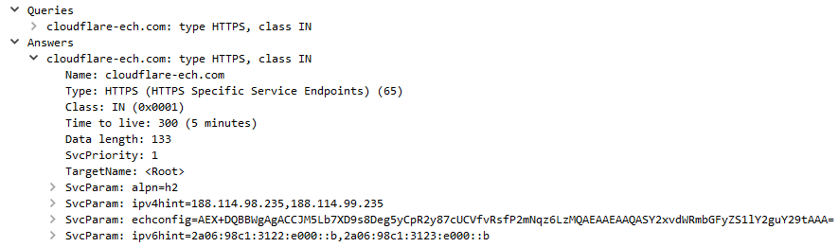
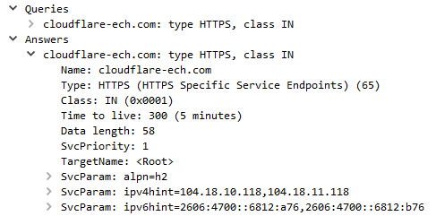
Brute force 2 - graceful ECH blocking
Graceful ECH blocking edits the HTTPS-RR response on-the-fly
avoiding QoE degradation !
Before
After

Slide 6
And if we can’t block ECH?
About half of all connections are uniquely identifiable by server IP address
for these we can build a Server IP Address Database (SIPAD)
About 45% of the connections belong to a gorilla IP group
such as Google, Meta, Amazon or a CDN
which have a small number of possible applications
for each of which we can train a small IP group ML classifier
The final about 5% of connections have rare server IP addresses
for which we can train a generic ML classifier

Slide 7


Centralized SIPAD architecture
Unmapped IPs
ISP
Deployment
NameServer
Automation
DataBase
NX
NSR
Records
ETL
RAW
NSR
Aggr.
SDE
IPREP
IPREP
ETL
RAW
DNDRs
Aggr.
DNDR
DNS
Queries
IPREP updates
DM
Input filter (x=DN)
HDR
SG
SG
DPI
SG
ISP Recursive
Name Server
DNS
http(s)
QUIC
DPI
DPI
DPI
DPI
DPI
DPI
DPI
DPI
DNDRs
DNDRs
DNDRs

Slide 8
DART2
DPI
SIPAD
report
IP group 1
IP group 2
IP group 3
…
generic
LEGEND
success
failure
either

Slide 9
How do we collect data for training ML classifiers? P5I!
Protocol Pack Probe for Per Packet Information = P⁵I
Hash-based sampling of connections from a live network
Label using Allot’s state-of-the-art DPI system
Adjustable sampling rate (currently about 400 raw connections per second)
Collect only usable nonencrypted features, such as
packet arrival time
packet direction
packet size
server IP address and port number
protocol number (TCP or UDP)

Slide 10
P5I format (simplified)
Field name | Size | Value | Comments
Client IP | 16 | Obfuscated IP address
Server IP | 16 | IP address
Protocol | 1 | Number | 6 - TCP, 17 - UDP
Client port # | 2 | Number
Server port # | 2 | Number | 443, 80, …
AppID | 4 | Number | unique app identifier
Time (ms) | 6 | Unix format time | ms since 1970 for first packet
Num packets | 2 | Number | Number of packets in the PPI
PPI | Up to 1400 | PPI Data | See next slide
Name | Size | Comments
Time | 2 | Time from FIRST packet in milliseconds (saturated to 0xFFFF)
Direction | 1 | 0 - Client2Server, 1 - Server2Client
Flags | 1 | TCP flags for TCP / UDP first payload byte for UDP
Size | 2 | Payload length (Bytes)

Slide 11
P5I Server IP statistics
Counting by connections, server IP addresses in or network map as follows:
about 50% map to essentially a unique application
about 40% have server IP addresses belonging to a gorilla
  Google (Google Services, Google Search, Gmail, Youtube Google maps, …)
  Meta (Facebook browsing, FB video, FB upload, Instagram, Whatsapp, …)
  Apple
  Amazon (Amazon shopping, AWS,
  Microsoft
  Cloudflare
  …
about 10% have unknown or rare server IP addresses

Slide 12
Performance test
We collected P5I traffic from the Pelephone alpha
at a rate of about 200 nontrivial connections per second
We tested DART2 by
training on 4 days of traffic (collected)
testing on a week of traffic from the following week
monitoring drift by testing on a week of traffic from 1 and 2 months later
When allowing 50 packets in the PPI, accuracy was about 94%
(for RF classifier, slightly better for deep LSTM)
and drift degradation under 2% per month
When limiting ourselves to 10 packet in the PPI
accuracies were about 1% lower

Slide 13
Next steps
The CTO Office team has implemented single-touch ML training
based on P5I files
The DPI software team has already implemented an SMPL-callable
Random Forest classifier
and will develop the SIPAD and model selection functions

Slide 14
YJS

