Slide 1
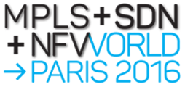
The evolviNG CPE
Yaakov (J) Stein
CTO

Slide 2
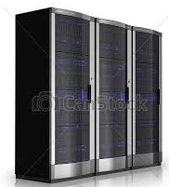
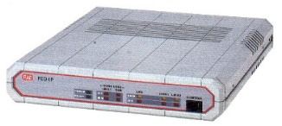

The CPE
The concept of Customer Premises Equipment
originally referred to functionalities at the Customer Premises
although it was later broadened to functionalities for the Customer Premises
Historically these functionalities were networking functionalities
Non-networking functions (IT functions)
were confined to servers at the customer site
and later moved to the cloud
Customer Premises
Customer Network

Slide 3



The evolviNG CPE
This CPE was well-adapted to services such as leased lines
where all the intelligence was at the edges
and the network functioned as a dumb pipe
Over time services acquired
on-path functionalities (middleboxes)
Data-Center based Value Added Services
reducing the importance of CP functionalities
Then came 2 opposing concepts, both confusingly called vCPE
pCPE : where only the minimal physical functionality remains at the CP
and intelligence is moved from the CP to the DC
uCPE : where new functionalities are moved from the DC to the CP
Customer Premises
Data Center
Customer
Network
Network

Slide 4


White boxes
Further complicating the terminology
people starting talking about white boxes
But white box means different things to different people
White box switch means an SDN (e.g., OpenFlow) switch
most frequently an inexpensive configurable hardware switch
possibly a configurable software switch (e.g., Open vSwitch)
White box server means a COTS computation platform
most frequently an x86-based CPU or VM capable of running VNFs
possibly combined with networking functionality
It is now realized that pure white box servers are not economically competitive
leading to the concept of a silver box
which is a white box server
with hardware acceleration for networking tasks

Slide 5

NG-CPE functionalities
Functionalities that may be hosted in the NG-CPE may include both :
networking functionalities and
computational (IT) functionalities

Slide 6



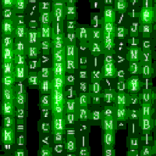


Computication
Once there was no overlap
between communications (telephone, radio, TV)
and computation (computers)
This dichotomy has certainly blurred in our private lives !
Most home computers are not used for computation at all
rather for communications (email, chat, VoIP)
Smart cellular telephones have become computers
and are used more for running apps than for telephone calls
But in professional contexts (business services, utilities operations, ...)
separate IT and communications departments are still the norm
switches/routers and servers are still acquired and operated differently

Slide 7
NG-CPE functionalities
The NG-CPE is a unified CP platform handling multiple functionalities, including:
physical networking functionalities (e.g., switching, OAM, encryption) (PNFs)
new value-added virtualized network functionalities (VNFs)
computational functionalities unrelated to networking (CFs)
Note: we shall use
red for hardware networking functions, i.e., PNFs
blue for virtual and virtualized functions, i.e., VNFs and CFs
purple for combined functions
PNFs
VNFs
CFs
NG-CPE =
L2 forwarding
L3 forwarding
FM
PM
protection switching
OAM
+
routing
NAT
firewall
DNS/DHCP
encryption
SD-WAN
+
IP-PBX
print-server
active directory
NAS
the sky is the limit

Slide 8
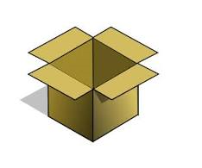



From D-NFV to NG-CPE
In previous talks I introduced the Distributed NFV (D-NFV) approach
and stressed the importance of (re)locating VNFs to where-ever they
are economically the most efficient
provide the highest performance
optimize security
Optimal location can be important for CFs as well
Now I want to further convince you of the advantages of merging
accidentally co-located, but disparate functionalities
into a single box
Isn’t this just a trick
and identical to placing a server next to a CPE ?

Slide 9
NG-CPE co-existence scenarios
To understand the advantages of merging VNFs and CFs
we need to consider three co-existence scenarios:
ships in the night
integrated data plane
integrated management plane

Slide 10

Ships in the night
In this simple scenario
the NE functionality, and
the VNF/VFs
can benefit from
low delay between them
lower real-estate, power and cooling costs
but nothing else
For example, a user-centric VAS could be provided as follows :
USER EQUIPMENT
NETWORK
compute node
user port PM
(e.g., Y.1564)
ingress TC
(e.g., policer)
ingress OAM
(UP MEP)
switch fabric
egress TC
(e.g., shaper)
egress OAM (DOWN MEP)
PHY
low delay

Slide 11
Integrated data plane
In this scenario the NE data plane is opened up to the VNF
but there is no common management plane
Merging enables tighter integration required for a SP-centric VAS
and thus greater functionality than in the previous scenario
Note: once functions are merged, some PNFs may be converted to VNFs
USER EQUIPMENT
NETWORK
user port PM
(e.g., Y.1564)
ingress TC
(e.g., policer)
ingress OAM
(UP MEP)
switch fabric
compute node
egress TC
(e.g., shaper)
egress OAM (DOWN MEP)
PHY
tight integration

Slide 12
Integrated data plane (cont.)
Even a generic bag of functions model is possible
This level of integration is only possible because of merging
Note: alternatively the switch fabric and all networking functions may be virtualized
compute node
compute functions
VNF
VNF
VNF
function chaining
. . .
USER EQUIPMENT
switch fabric
NETWORK
PHY
PHY
networking functions
user port PM
(e.g., Y.1564)
ingress TC
(e.g., policer)
ingress OAM
(UP MEP)
egress TC
(e.g., shaper)
egress OAM (DOWN MEP)

Slide 13
Integrated management plane
The tightest integration is obtained when the merged functionalities
are co-managed
This enables new capabilities we have discussed before, such as
rich communications services
joint SDN/NFV optimization
The NE and NFV components were previously managed -
the NE by an NMS or SDN controller
the NFV by MANO (orchestrator + VNFM + VIM)
And there are three methods of integrating these management systems:
1. NMS/SDN on top
2. Orchestrator on top
3. Orchontroller (combined orchestrator / controller)
We will depict these cases assuming SDN-controlled network

Slide 14
SDN on top
app
app
app
app
Here the SDN controller
and the network apps above it
control all functionality
This method is advantageous because network apps can be written by third parties
This architecture is compatible with BBF WT-328 and WT-359
It differs from ONF TR-518 mainly in the use of the orchestrator
The new SDN-NFV interface
is similar to the ETSI Os-Ma interface
may be based on extensions of the MEF Presto interface
joint NBI
SDN controller
SDN-NFV interface
SDN SBI
MANO
NFV SBI
NG-CPE
NG-CPE
NG-CPE
NG-CPE
NG-CPE
NG-CPE
NG-CPE
NG-CPE
NG-CPE
NG-CPE
NG-CPE
NG-CPE

Slide 15
Orchestrator on top
NFV
Orchestrator
SDN-NFV interface
Here the NFV orchestrator
controls all functionality of the rich communications service
New network applications need to be built into the orchestrator (not 3rd party apps), as is customary in the SP world
This architecture is compatible with ETSI NFV-EVE005 (which details further possibilities)
The new SDN-NFV interface
may be based on any SDN NBI
may be similar to OS Neutron
SDN controller
SDN SBI
VIM/VNFM
NG-CPE
NG-CPE
NFV SBI
NG-CPE
NG-CPE
NG-CPE
NG-CPE
NG-CPE
NG-CPE
NG-CPE
NG-CPE
NG-CPE
NG-CPE

Slide 16
Orchontroller
app
app
app
app
Here the SDN controller and the entire MANO have been fully integrated
The SDN approach of network apps
is optional
This merged management is not presently specified by any SDO, but facilitates:
defining rich communications services
joint SDN/NFV optimization
joint NBI
Orchontroller
joint
SBI
NG-CPE
NG-CPE
NG-CPE
NG-CPE
NG-CPE
NG-CPE

Slide 17

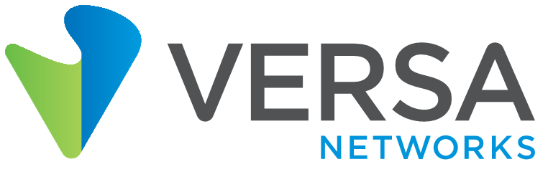








RAD-Versa Live SD-WAN Demo
Integrated NOC
RAD Booth #301
RADview
D-NFV Orchestrator PM Portal
Versa
Director
SD-WAN
Controller
Analytics
Customer Site A
Customer Site B
Versa FlexVNF
Versa FlexVNF
SD-WAN PM
Open vSwitch
Open vSwitch
App Clients
KVM Hypervisor
KVM Hypervisor
App Clients
Video
Internet
Video
Data
Data
ETX-2i with DNFV
ETX-2i with DNFV
QoS-Assured VPN
IPPM
Video Streaming + File Transfer

Slide 18
NG-CPE is a computications enabler
D-NFV pioneered deployment of networking functionality
where-ever most suitable
However, D-NFV maintained the distinction
between networking functions (whether physical or virtualized)
which could be placed where-ever most suitable
and pure compute functions
which could not be relocated
The present extension completely blurs the NF/CF distinction -
any functionality can be deployed anywhere
networking and computation can be jointly managed
The NG-CPE’s calling
is to overcome the artificial computation-communications divide

